Slide 1

CMSC 137
Data Communications and Networking
Lecture Module
03 – TCP/IP Protocol Suite

Slide 2
Module 3: TCP/IP Protocol Suite
Rozano S. Maniaol
Lecturer

Slide 3
Protocol Layering

Slide 4






Sending a message
Penny
Amy
Talk
Listen
Listen
Talk
Plaintext
Encrypt
Decrypt
Decrypt
Encrypt
Ciphertext
Send mail
Send mail
Receive mail
Receive mail

Slide 5
Protocol Layering
Principles:
Each layer needs to have two opposite tasks
Corresponding layers should be identical
Penny
Amy
Talk
Listen
Listen
Talk
Layer 1
Plaintext
Identical objects
Layer 2
Encrypt
Decrypt
Ciphertext
Decrypt
Encrypt
Identical objects
Layer 3
Send mail
Mail
Identical objects
Send mail
Receive mail
Receive mail

Slide 6


Sending a message
Penny
Amy
Talk
Listen
Listen
Talk
Plaintext
Encrypt
Decrypt
Decrypt
Encrypt
Ciphertext
Change encryption method
Send mail
Send mail
Receive mail
Receive mail
Change delivery mode

Slide 7
TCP/IP Protocol Suite

Slide 8
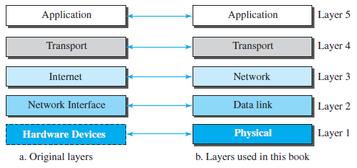
TCP/IP Protocol Suite
Hierarchical protocol made up of interactive modules – upper-level protocol is supported by one or more lower-level protocols
Also called the Internet Protocol Suite

Slide 9
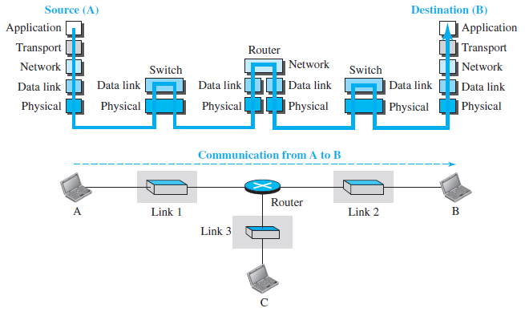
TCP/IP Protocol Suite

Slide 10
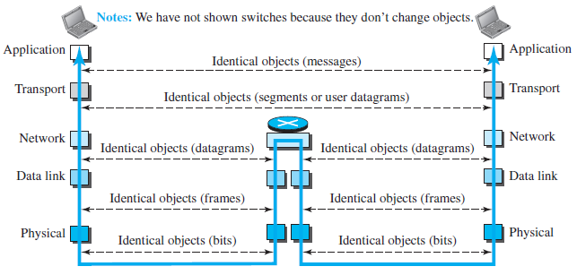
Identical Objects

Slide 11
Physical Layer
Identifies the characteristics of the hardware to be used for the network
Responsible for carrying individual bits in a frame across the link
Communication is still logical (bits); a hidden layer underneath (transmission media) carries electrical/optical signals

Slide 12
Data Link Layer
Identifies the network protocol type of the packet
TCP/IP does not define any specific protocol for data link layer. It supports all the standard and proprietary protocols

Slide 13
Network Layer
Responsible for host-to-host communication and routing the packets through possible routes
Internet Protocol (IP) [RFC 791]
  Defines the format of the packet (datagram)
  Defines the format and structure of the addresses used in this layer
  Connectionless protocol that provides no flow control, no error control and no congestion control services

Slide 14
Network Layer
Auxiliary protocols
Internet Control Message Protocol (ICMP) – helps IP to report some problems when routing a packet
Internet Group Management Protocol (IGMP) – helps IP in multitasking
Dynamic Host Configuration Protocol (DHCP) – helps IP to get network-layer address for a host
Address Resolution Protocol (ARP) – helps IP find the link-layer address of a host or a router when its network-layer address is given

Slide 15
Transport Layer
Responsible for giving services to the application layer
Transmission Control Protocol (TCP) [RFC 793]
  Connection-oriented protocol that first established a logical connection between transport layers at 2 host before transferring data
  flow control – match sending data rate of the source host with receiving data rate of the destination to prevent from overwhelming the destination
  error control – guarantee that segments arrive at the destination without error and resending the corrupted ones
  congestion control – to reduce the loss of segments due to the congestion in the network

Slide 16
Transport Layer
User Datagram Protocol (UDP) [RFC 768]
  Connectionless protocol that transmits user datagrams without first creating a logical connection
  Adds only port addresses, checksum error control, and length information
Stream Control Transmission Protocol (SCTP) [RFC 4960]
  Best of TCP and UDP
  Designed to respond to new applications that are emerging in the multimedia

Slide 17
Application Layer
Process to process communication
Hypertext Transfer Protocol (HTTP) – vehicle for accessing the World Wide Web (WWW)
Simple Mail Transfer Protocol (SMTP) – main protocol used in electronic mail service
File Transfer Protocol (FTP) – used for transferring files from one host to another
Terminal Network (Telnet) and Secure Shell (SSH) – used for accessing remote sites
Simple Network Management Protocol (SNMP) – used by an administrator to manage the Internet at global and local levels

Slide 18


Encapsulation and Decapsulation
Application
Message
Message
Transport
H4
Message
H4
Message
Network
H3
Segment
H3
Segment
H3
Segment
Data Link
H2
T2
H2
H2
T2
Datagram
Datagram
T2
H2
Datagram
T2
Physical
10101001010101010101
1110100101011010111
10101001010101010101
1110100101011010111

Slide 19
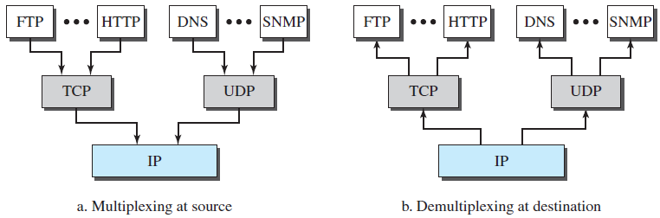
Multiplexing and Demultiplexing

Slide 20
Addressing

Slide 21
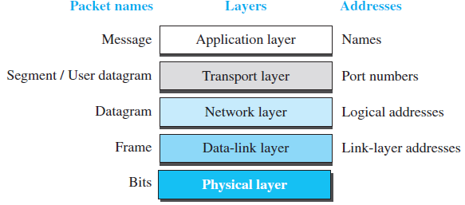
TCP/IP Addressing

Slide 22
Link-layer Address
Also called physical address or MAC address
Lowest-level address defined by a node's LAN or WAN
Size and format varies depending on network
  Example: Ethernet uses 6-byte physical addresses written as 12 hexadecimal digits separated by a colon
    68:a3:c4:ce:8c:e2
Organizationally Unique Identifier (OUI)
  Dell: 00-14-22
  Nortel: 00-04-DC
  Cisco: 00-40-96
  Belkin: 00-30-BD

Slide 23
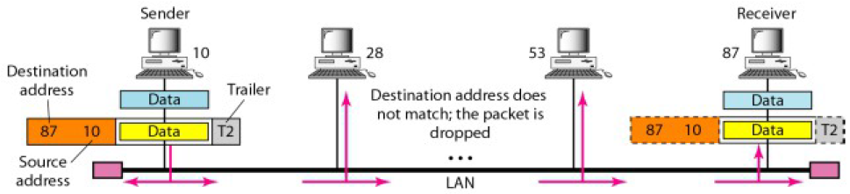
Link-layer Address

Slide 24
Logical Address
Necessary for universal communications – internetworks
Internet (IP) address is 32 bits
No two publicly addressed and visible host on the Internet can have the same logical address

Slide 25
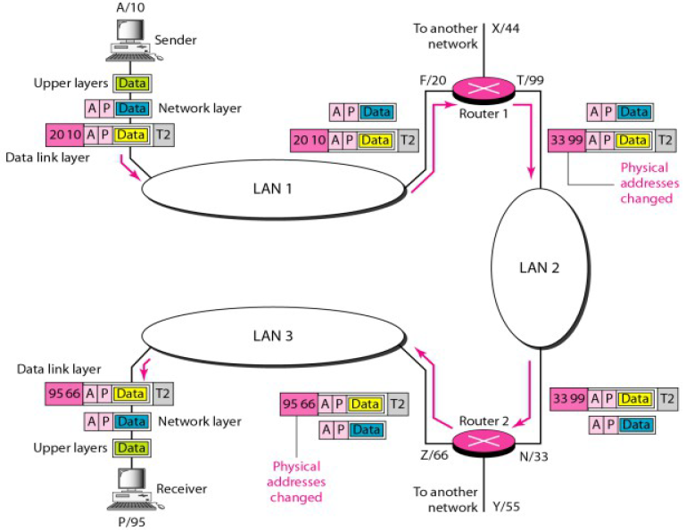
Logical Address
The physical addresses (numbers) changes between LANs but the logical addresses (letters) does not

Slide 26
Port Number
Ultimate objective of Internet communication is a process communicating with another (peer) process running on a remote computer
TCP/IP Port address – assigned to a process, 16 bits
Examples: 80, 23, 22, 21, 8080

Slide 27
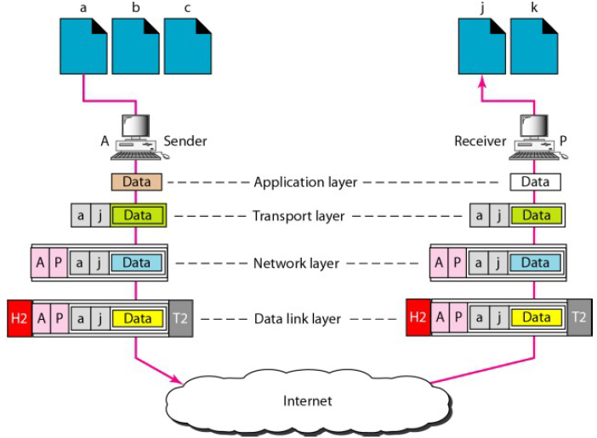
Port Number

Slide 28
Names/Specific Names
User-friendly addresses
  Example: email addresses, URL
Changed to corresponding port and logical addresses

Slide 29
How it works

Slide 30
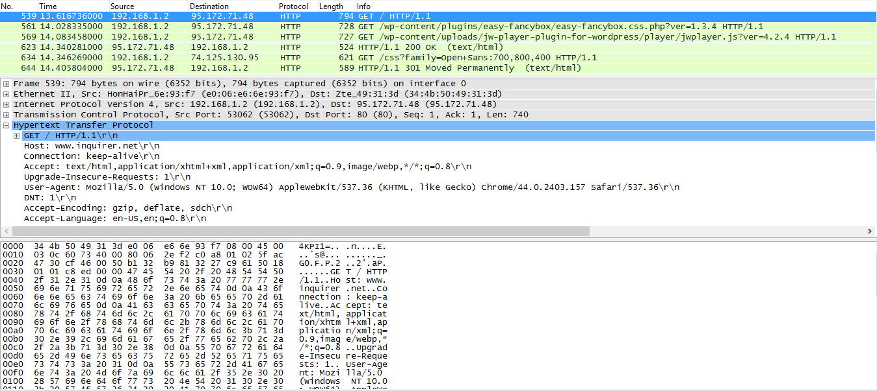
Sample Packet

Slide 31
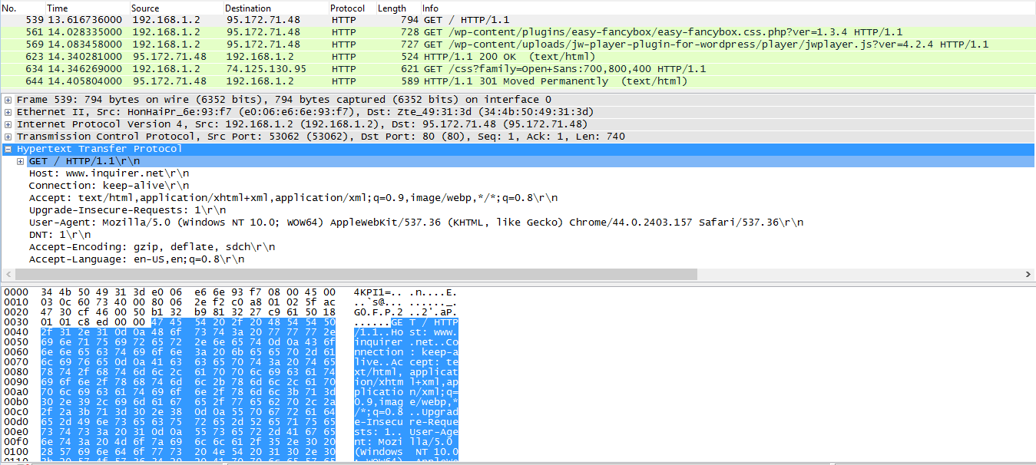
HTTP Packet (Application Layer)

Slide 32
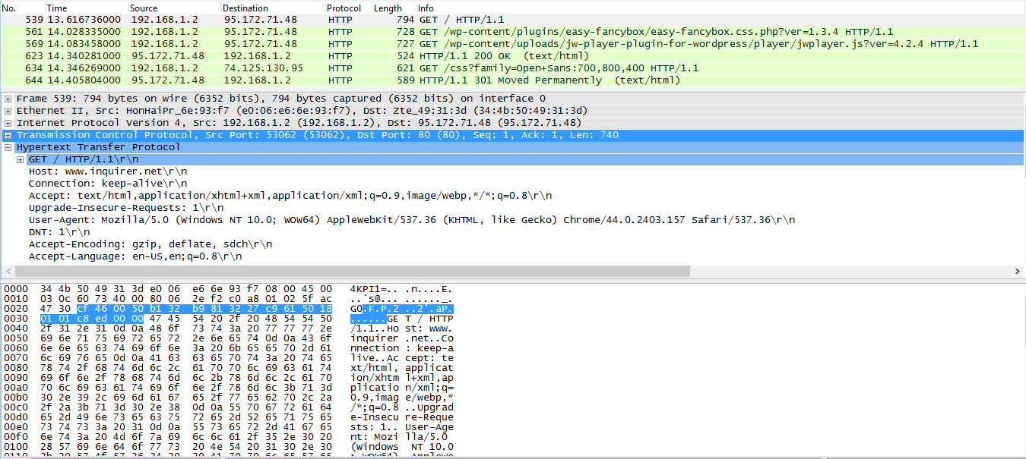
TCP Header (Transport Layer)
Port numbers

Slide 33
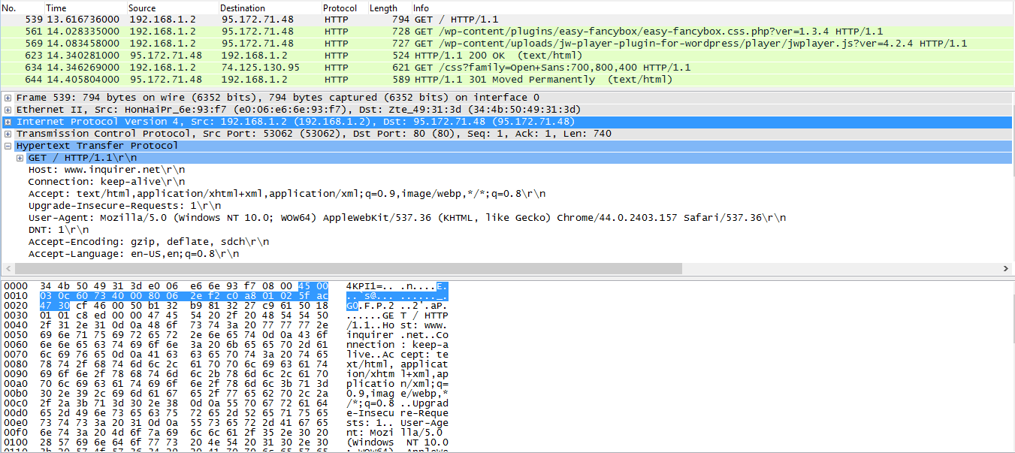
IPv4 Header (Network Layer)
IP addresses

Slide 34
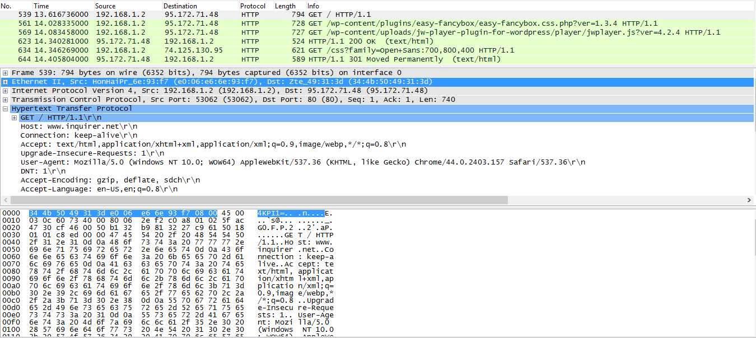
Frame Header (Data Link Layer)
Physical addresses

Slide 35
References
Forouzan, B.A. 2013. Data Communications and Networking, 5th Ed. McGraw-Hill, New York.

